Slide 1



Quora Web Solution
Website Design and
Development
Company
Web Design & Web Development
Company in Bangalore, India
www.quorawebsolution.com
+91 9986 056 909
info@quorawebsolutions.com
24A, 1st Main Rd, Chandra Reddy
Layout, Koramangala 4th Block,
Koramangala, Bengaluru,
Karnataka 560034

Slide 2
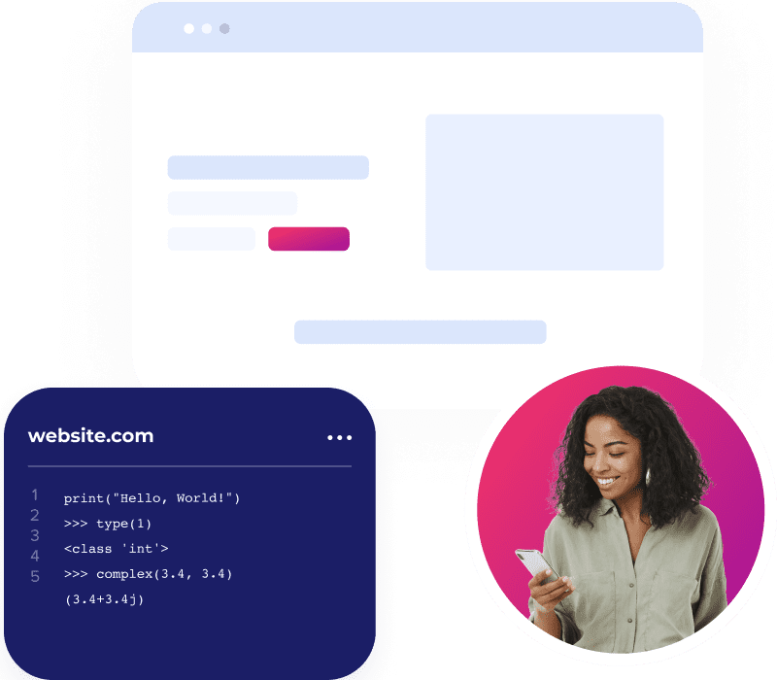
Cutting-Edge Website Design and Development Services: Stay Ahead of the Curve
www.quorawebsolution.com

Slide 3

A strong online presence is essential for business success.
www.quorawebsolution.com

Slide 4
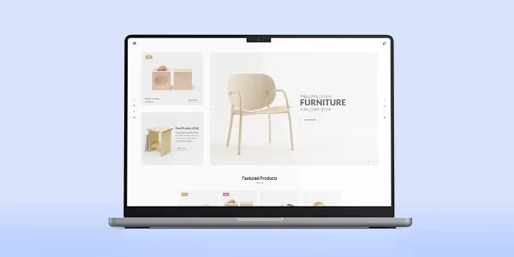
A well-designed and developed website can significantly impact your brand's image, customer engagement, and overall business success.
www.quorawebsolution.com

Slide 5
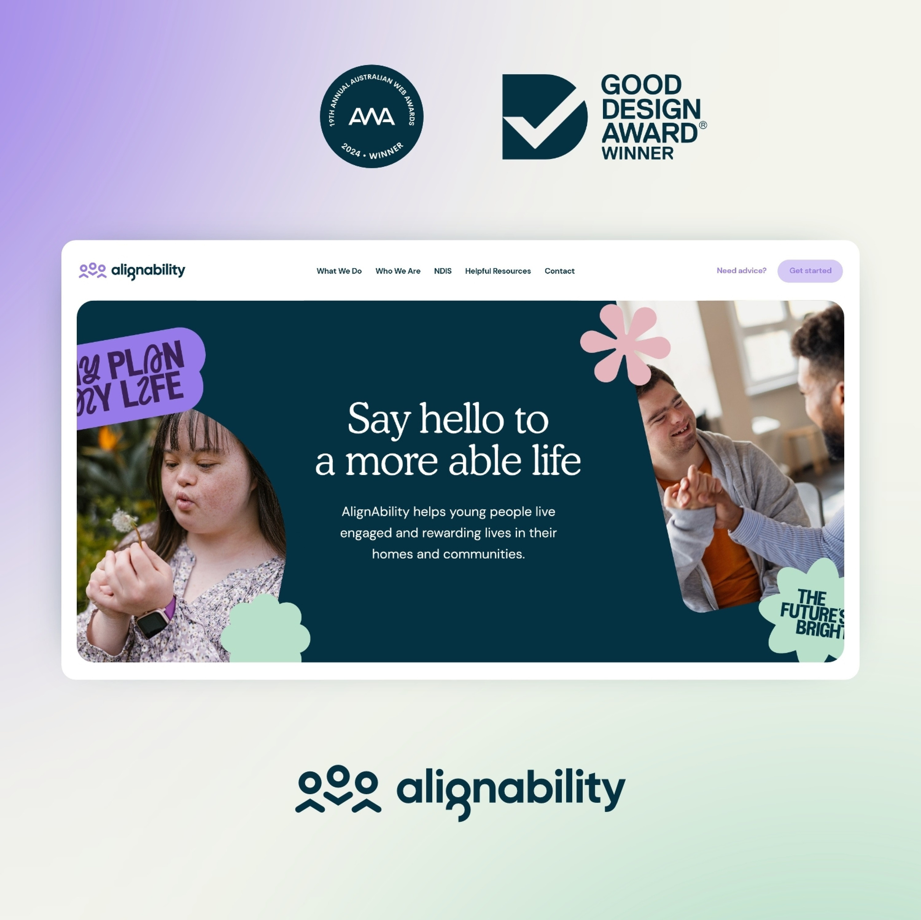
To stay competitive, it's crucial to partner with a cutting-edge website design and development company.
www.quorawebsolution.com

Slide 6
What to Look for in a Website Design and Development Company
When selecting a company to handle your website project, consider the following key factors:
  Expertise and Experience: Look for a company with a proven track record of delivering high-quality websites across diverse industries.
  Creative Design Skills: A strong design team can create visually appealing and user-friendly websites that align with your brand's identity.
  Technical Proficiency: Ensure the company has the latest technical skills to implement the latest web technologies and frameworks.
www.quorawebsolution.com

Slide 7
  SEO Expertise: A website optimized for search engines can drive organic traffic and improve your online visibility.
  Responsive Design: Your website should be accessible and look great on all devices, from desktops to smartphones.
  E-commerce Capabilities: If you plan to sell products or services online, the company should have expertise in developing secure and efficient e-commerce platforms.
  Content Management System (CMS) Knowledge: A CMS can make it easier to manage and update your website content.
  Project Management Skills: A well-organized project management team can ensure timely delivery and effective communication.
  Client Communication: Strong communication is essential to ensure that your vision is realized.
www.quorawebsolution.com

Slide 8
Key Services Offered by Top-Tier Companies
  Website Design: Creating visually stunning and user-friendly website designs that capture your brand's essence.
  Website Development: Building robust and scalable websites using the latest technologies and frameworks.
  E-commerce Development: Developing online stores with secure payment gateways, inventory management, and seamless checkout processes.
  Web Application Development: Creating custom web applications tailored to your specific business needs.
  SEO and Digital Marketing: Implementing effective SEO strategies to improve your website's search engine rankings and driving organic traffic.
www.quorawebsolution.com

Slide 9
  Website Maintenance and Support: Providing ongoing maintenance and support to keep your website running smoothly and securely.
Why Choose a Cutting-Edge Website Design and Development Company?
Partner with a cutting-edge company to reap numerous benefits.
  Enhanced Brand Image: A well-designed website can elevate your brand's image and credibility.
  Improved User Experience: A user-friendly website can increase engagement, reduce bounce rates, and boost conversions.
  Increased Online Visibility: SEO and digital marketing can help you attract more organic traffic and generate more leads.
  Higher Conversion Rates: A well-optimized website can drive more sales and revenue.
www.quorawebsolution.com

Slide 10
  Competitive Advantage: Stay ahead of your competitors with a modern and innovative website.
In conclusion, investing in a high-quality website is an investment in your business's future. By choosing a cutting-edge website design and development company, you can ensure that your online presence is both visually appealing and functionally superior, helping you achieve your business goals.
Unveiling the Digital Architects: Top Website Design and Development Companies Reshaping the Online Landscape
In today's digital age, a strong online presence is no longer a luxury but a necessity. A well-designed and developed website can significantly impact your brand's image, customer engagement, and overall business success.
www.quorawebsolution.com

Slide 11
To stay ahead of the curve, it's crucial to partner with a top-tier website design and development company.
The Power of a Well-Crafted Website
A well-designed website offers numerous benefits:
  Enhanced Brand Image: A visually appealing and professional website can elevate your brand's credibility.
  Improved User Experience: A user-friendly website can increase engagement, reduce bounce rates, and boost conversions.
  Increased Online Visibility: Effective SEO strategies can help you attract more organic traffic and generate more leads.
  Higher Conversion Rates: A well-optimized website can drive more sales and revenue.
  Competitive Advantage: Stay ahead of your competitors with a modern and innovative website.
Key Factors to Consider When Choosing a Website Design and Development Company
www.quorawebsolution.com

Slide 12
When selecting a company to handle your website project, consider the following factors:
  Expertise and Experience: Look for a company with a proven track record of delivering high-quality websites across diverse industries.
  Creative Design Skills: A strong design team can create visually appealing and user-friendly websites that align with your brand's identity.
  Technical Proficiency: Ensure the company has the latest technical skills to implement the latest web technologies and frameworks.
  SEO Expertise: A website optimized for search engines can drive organic traffic and improve your online visibility.
  Responsive Design: Your website should be accessible and look great on all devices, from desktops to smartphones.
www.quorawebsolution.com

Slide 13
  E-commerce Capabilities: If you plan to sell products or services online, the company should have expertise in developing secure and efficient e-commerce platforms.
  Content Management System (CMS) Knowledge: A CMS can make it easier to manage and update your website content.
  Project Management Skills: A well-organized project management team can ensure timely delivery and effective communication.
  Client Communication: Strong communication is essential to ensure that your vision is realized.
Top Website Design and Development Companies
Here are some of the top-tier website design and development companies that are reshaping the online landscape:
[Company 1]
www.quorawebsolution.com

Slide 14
  Strengths: [Highlight key strengths, such as innovative design, cutting-edge technology, or exceptional client service.]
  Notable Projects: [List some of their most impressive projects.]
[Company 2]
  Strengths: [Highlight key strengths, such as industry expertise, SEO prowess, or e-commerce specialization.]
  Notable Projects: [List some of their most impressive projects.]
[Company 3]
  Strengths: [Highlight key strengths, such as user-centric design, responsive development, or digital marketing expertise.]
  Notable Projects: [List some of their most impressive projects.]
[Company 4]
  Strengths: [Highlight key strengths, such as cloud solutions, data-driven design, or global reach.]
www.quorawebsolution.com

Slide 15
  Notable Projects: [List some of their most impressive projects.]
[Company 5]
  Strengths: [Highlight key strengths, such as agile development methodologies, AI-powered tools, or social media integration.]
  Notable Projects: [List some of their most impressive projects.]
By partnering with a top-tier website design and development company, you can unlock the full potential of your online presence and achieve your business goals.
Remember to conduct thorough research and consider your specific needs when selecting a company. A well-chosen partner can help you create a website that not only looks great but also drives results.
www.quorawebsolution.com

Slide 16
Quora Web Solution: Quora Web Solution is a trusted website development company based in Bangalore, India, offering a wide array of services to not only domestic but global clientele. Be it Website Design and Development, SEO services, Digital Marketing, Branding, App Development, Ecommerce Solution, and Logo Creation . Quora Web Solution has the best website developers offering top quality services and that is the reason why we are well known as one of the best Website Development Companies in Bangalore, India.
Visit Us - www.quorawebsolution.com
Call Us - +91 9986 056 909
Mail Us - info@quorawebsolutions.com
www.quorawebsolution.com

Slide 17




Services
WORDPRESS DEVELOPMENT
ECOMMERCE DEVELOPMENT
PHP DEVELOPMENT
CMS DEVELOPMENT
DRUPAL DEVELOPMENT
WEBSITE SERVICES
WEBPORTAL DEVELOPMENT
MAGENTO DEVELOPMENT
WEBSITE DEVELOPMENT
JOOMLA DEVELOPMENT
SMALL BUSINESS DEVELOPMENT
CHEAP WEBSITE DEVELOPMENT
STATIC WEBSITE DEVELOPMENT
DYNAMIC WEBSITE DEVELOPMENT
WEBSITE DESIGN COMPANY
TOUR AND TRAVEL WEBSITE DEVELOPMENT

